Slide 1
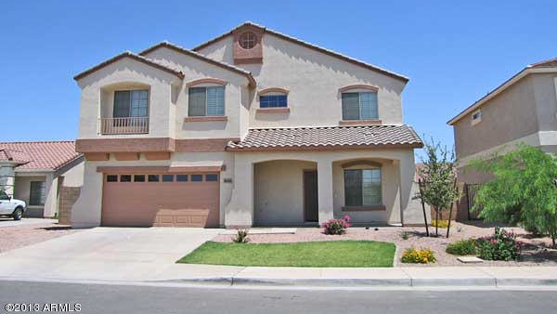

RentEASY - Rent With Ease

Slide 2

Mentor: Prof. Hitesh Patel
Group: G46
Group Member:
Keshvi Patel
Tejas Patel
Tirth Patel
Vishakha Rajput

Slide 3

Introduction
The concept behind RentEasy is quite simple: It connects hosts who have available space, ranging from entire homes to single rooms, with guests looking for a place to stay.
Hosts can list their properties on the platform, providing detailed descriptions, photos, and other relevant information to showcase their offerings.
Guests, on the other hand, can browse through these listings and book the accommodation that best suits their needs and preferences.

Slide 4
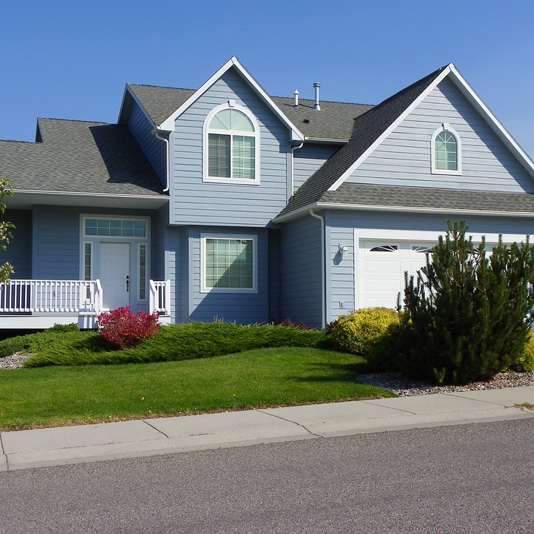
Abstract
The travel and hospitality industry primarily revolved around traditional hotels, motels, and other established accommodations.
However, several challenges existed within this traditional model like Limited Accommodation Options, High Costs, Underutilization of Spare Spaces, Lack of Flexibility, Less Cultural Immersion etc.
To overcome these problems RentEasy provides key features like Flexible Booking Options, Diverse Accommodations, Global Presence, Host and Guest Reviews, Safety and Trust, Enhanced User Experience etc.

Slide 5
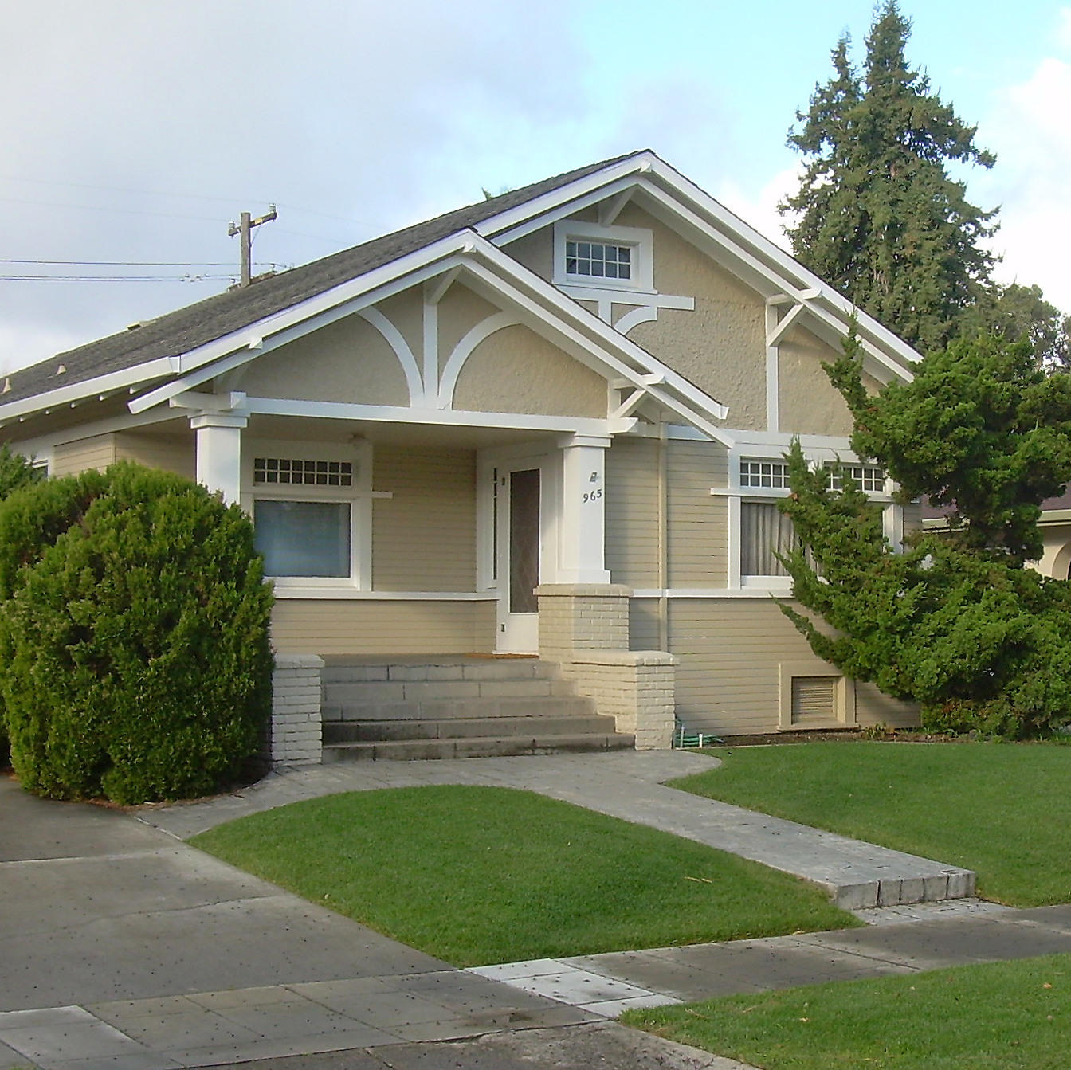
Objectives Of Study
The major goal of RentEasy is to create a global platform that connects hosts who have available accommodations with guests seeking for short-term stays.
Following are our objectives:
User-Friendly
Easy to Use
Connect Hosts and Guests
Provide Unique Accommodation Options
Enable Entrepreneurship
Promote Responsible and Sustainable Travel
Facilitate Cultural Exchange
Trust and Safety

Slide 6
System Analysis

Slide 7
Host
Host Registration and Profile Creation: Hosts sign up on RentEasy, create their profiles, and provide relevant information about themselves and their properties.
Listing Management: Create and manage accommodation listings, such as property type, amenities, house rules, and pricing.
Pricing Management: Hosts set pricing for their accommodations, including seasonal rates and additional fees.
Booking and Reservation Management: Hosts manage bookings, including accepting or declining reservation requests. This involves analyzing the calendar system and identifying any potential issues that could affect booking accuracy.

Slide 8
Host
Reviews and Ratings: Hosts receive and respond to guest reviews and ratings that helps host to assess their performance and reputation. Hosts may use feedback to improve their offerings and maintain a positive reputation on the platform.
Cancellation Policies: Hosts handle cancellations of guest accommodation. The platform will have clear and fair cancellation policies for both hosts and guests.
Safety and Security Measures: Hosts can ensure the safety of their guests. This involves examining features such as verified identification, secure payment processing etc.

Slide 9
Guest
User Registration and Profile Creation: Guests sign up on RentEasy, create their profiles, and provide relevant information about themselves.
Search and Accommodation Discovery: Guests search for accommodations and discover listings that match their preferences. This includes evaluating search filters, and other features that help guests find suitable options based on location, amenities, price, and more.
Booking and Reservation Management: Guests initiate booking requests, communicate with hosts, and manage their reservations.
Reviews and Ratings: Guests provide reviews and ratings for their host experiences helps to assess host performance and helps future guests make informed decisions.

Slide 10
Guest
Safety and Trust: Safety measures such as host identity verification, guest reviews, is used for building trust and ensuring a secure experience for guests.
Data Privacy and Compliance: Data privacy policies and compliance ensures that guest information is handled responsibly.
Analytics and Travel Insights: Data and insights provided to guests, such as travel history, preferences, and recommendations, helps guests to make informed decisions for future trips.

Slide 11
Technologies

Slide 12

Next.js 13 with file-based routing for easy development
Tailwind CSS for fast and responsive styling
Prisma ORM for efficient database management
NextAuth.js for seamless authentication
Cloudinary for image and video management
SWR for fast data fetching and caching
TypeScript for static typing
MongoDB as a database

Slide 13
Requirements

Slide 14

Software Requirements
Frontend Tools: Next Js, Tailwind CSS, TypeScript
Database: Mongo DB
ORM: Prisma
OS: Windows
Browser: Google Chrome, Mozilla Firefox etc.
Hardware Requirements
Host Configuration Processor: 2.20GHz RAM: 8GB Hard Disk: 1TB free space | Guest Configuration Processor: 2.20GHz RAM: 2GB Hard Disk: 4GB free space

Slide 15
Diagrams

Slide 16

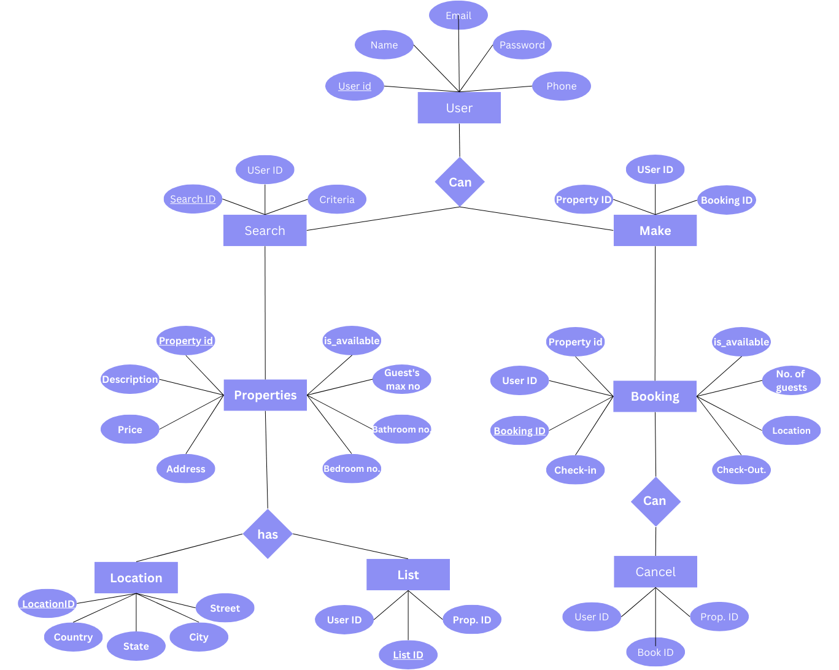
Entity Relationship Diagram

Slide 17
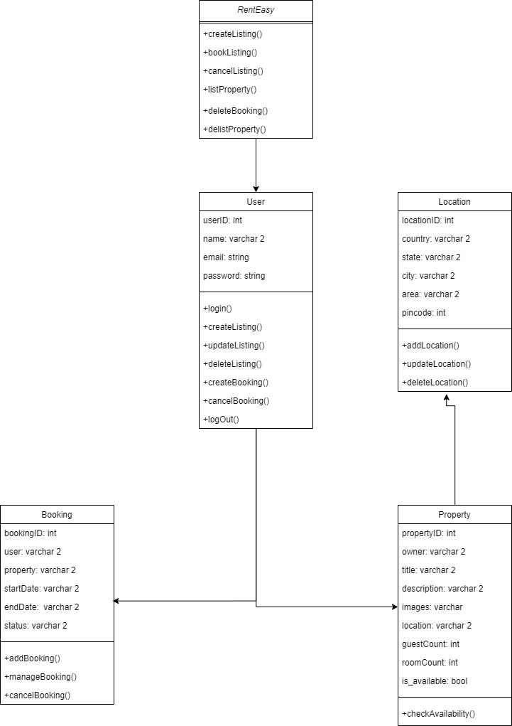
Class Diagram

Slide 18
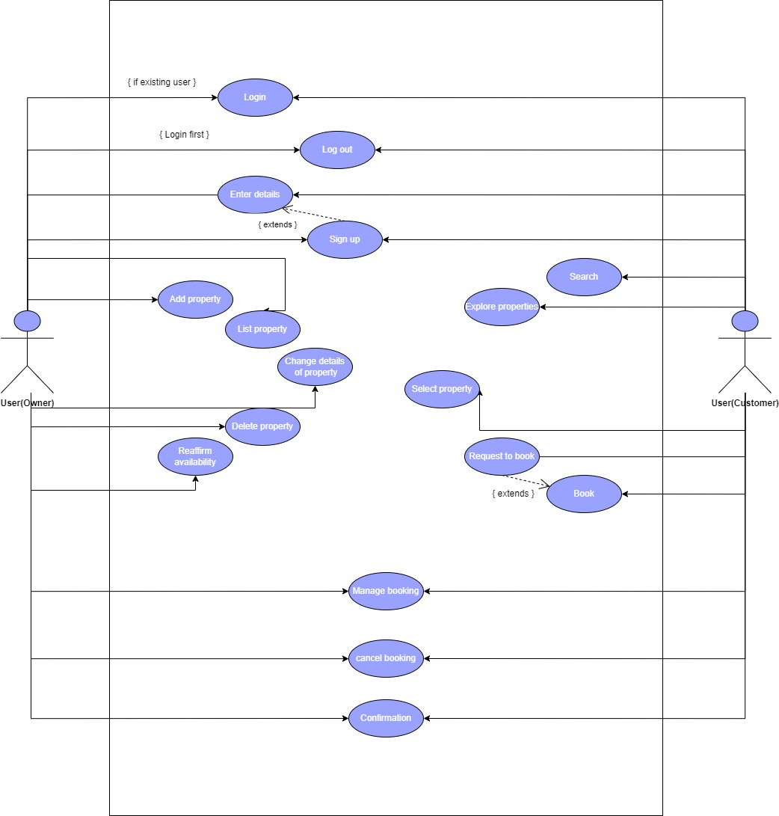
Use Case Diagram

Slide 19
Screenshots

Slide 20
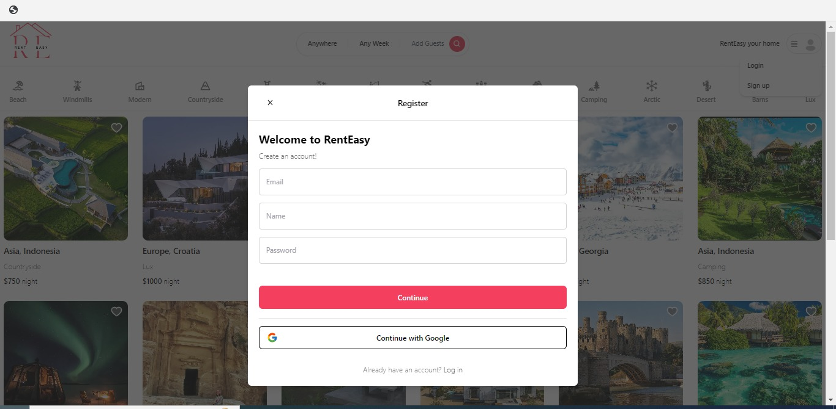
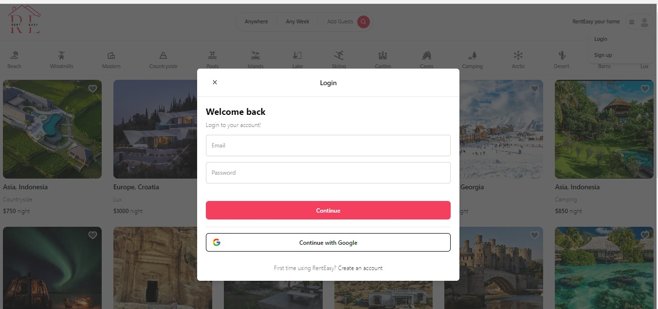

Slide 21
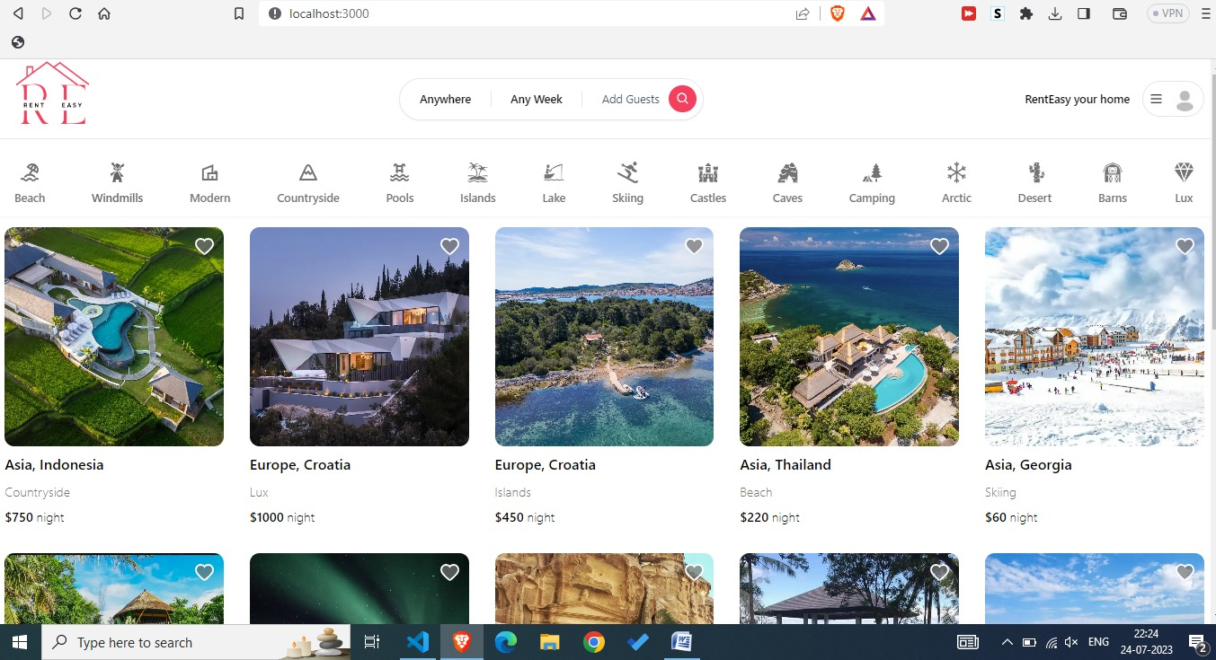

Slide 22
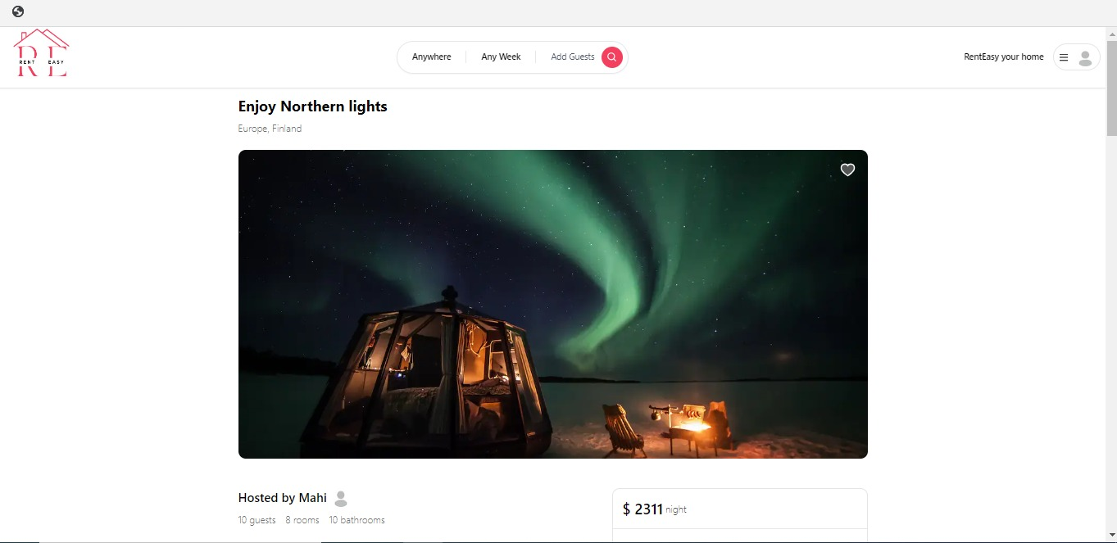
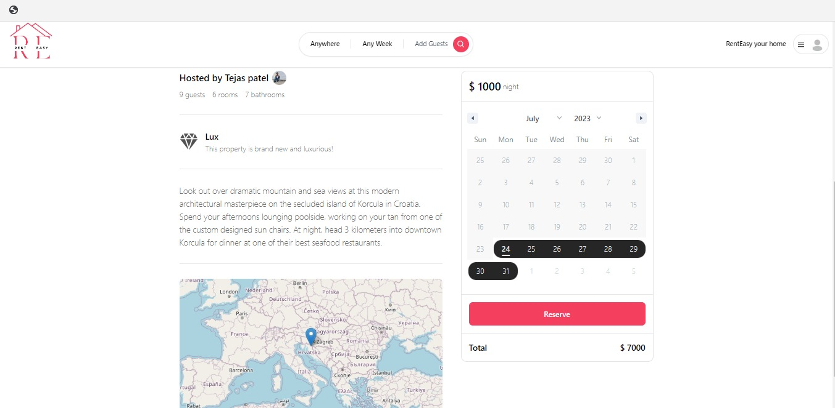

Slide 23
References

Slide 24

References
https://www.typescriptlang.org/docs/handbook/2/basic-types.html
https://react-icons.github.io/react-icons/search?q=cross
https://www.mongodb.com/
https://www.google.com/
https://nextjs.org/docs
https://tailwindui.com/components?ref=sidebar

Slide 25



Thank you

